Slide 1
Vertical Position Reconstruction Update

Slide 2
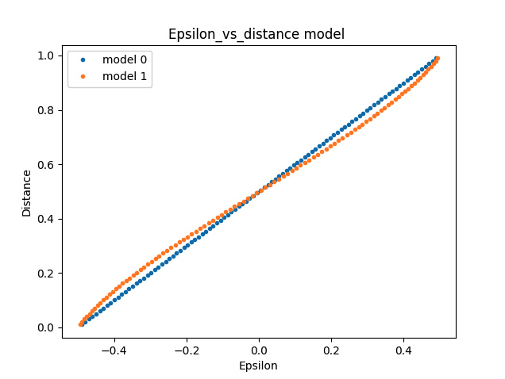
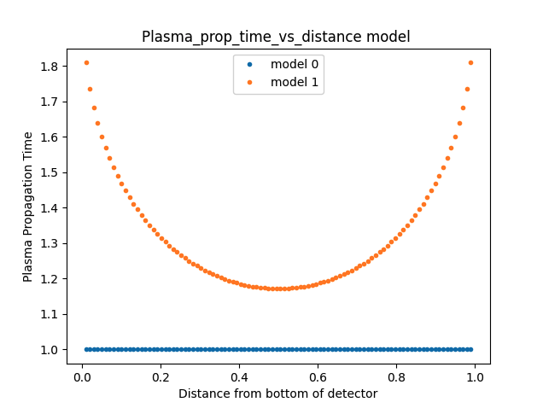
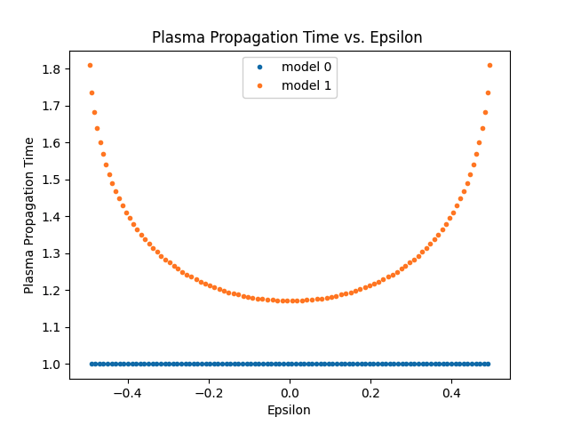
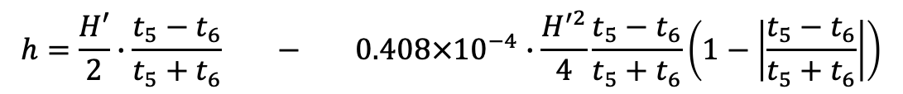
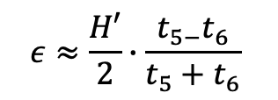
$$ε≈\frac{H′}{2}∙\frac{t_{5−}t_{6}}{t_{5}+t_{6}}$$
Messagew York betsy ---
$$h=\frac{H′}{2}∙\frac{t_{5}−t_{6}}{t_{5}+t_{6}} − 0.408×{10}^{−4}∙\frac{H^{′2}}{4}\frac{t_{5}−t_{6}}{t_{5}+t_{6}}\left(1−\left|\frac{t_{5}−t_{6}}{t_{5}+t_{6}}\right|\right)$$

Slide 3
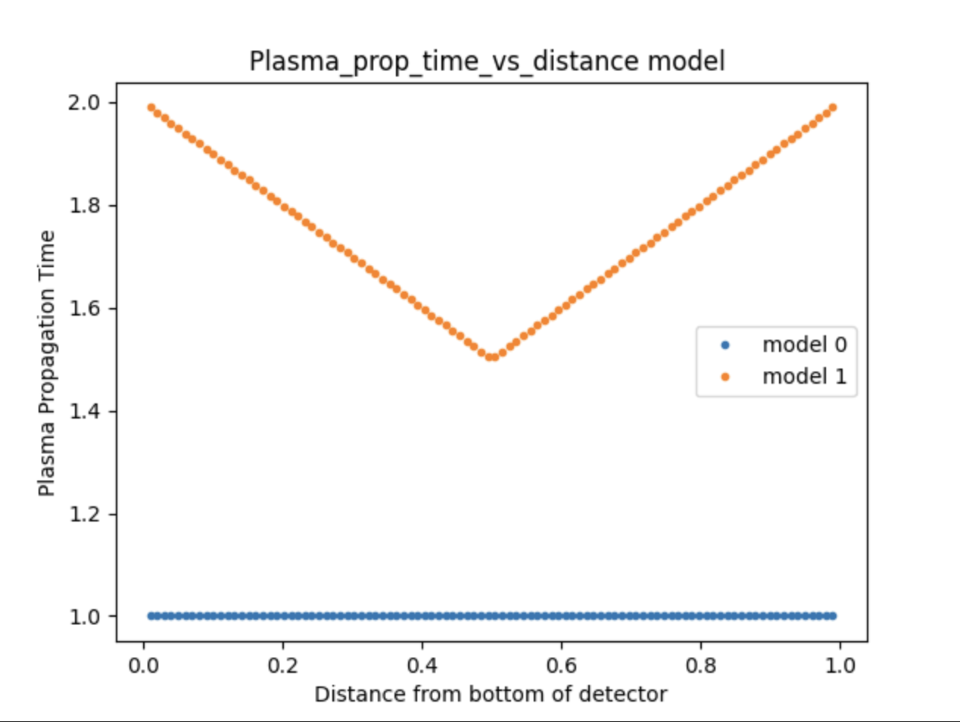
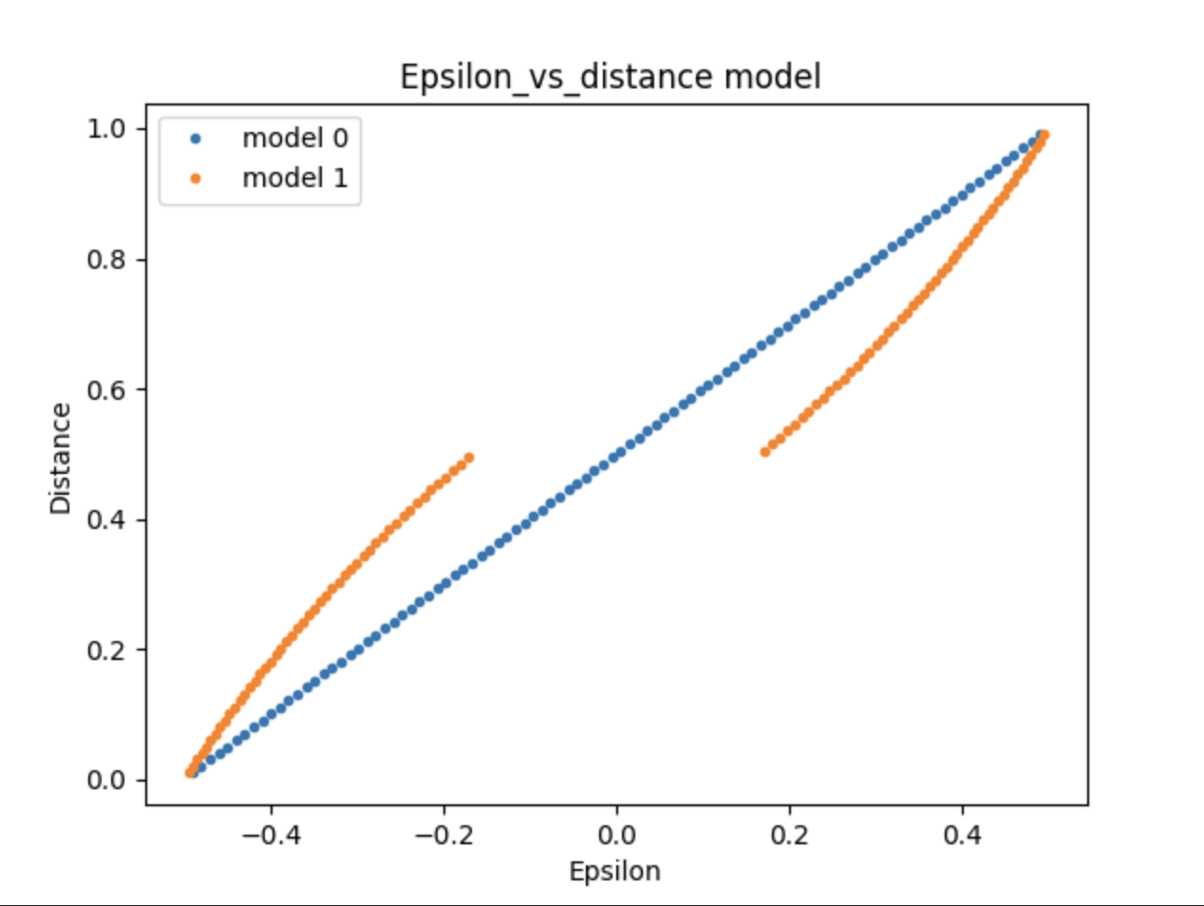
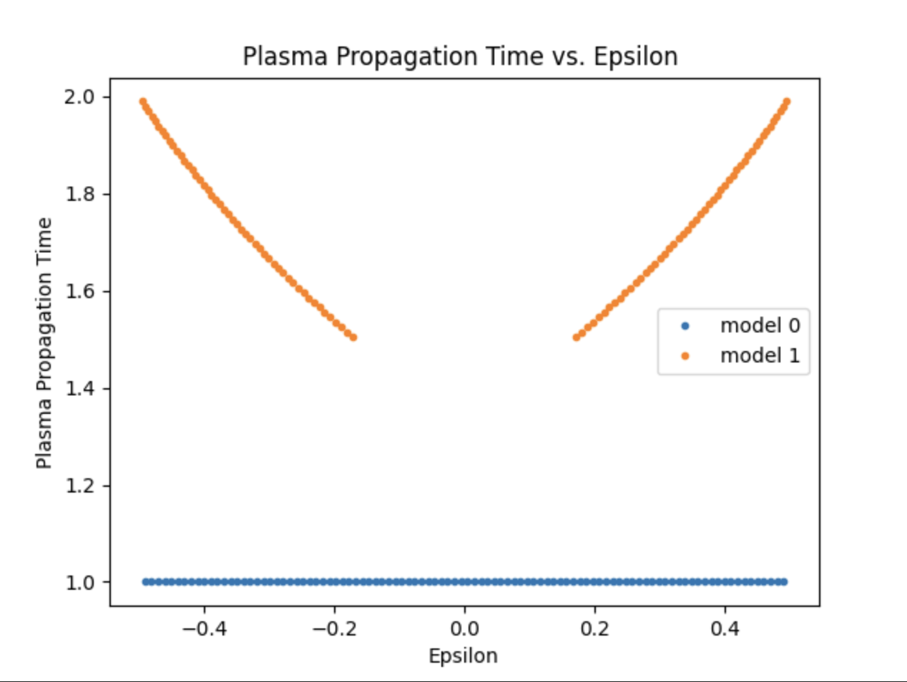

Slide 5
Can be added to nemo-3 read stuff on docdb?

Slide 6


Vertical Position Reconstruction Overview
SuperNEMO Collaboration Meeting - Edinburgh
04/06/23
Sam Pratt

Slide 7
Tracker Timestamp Overview
SuperNEMO tracker cells are used to measure e- position in detector
Timestamps used to calculate vertical position can be faulty
How do we recover position measurements in these cases?
How do we assess the uncertainty on these positions?

Slide 8
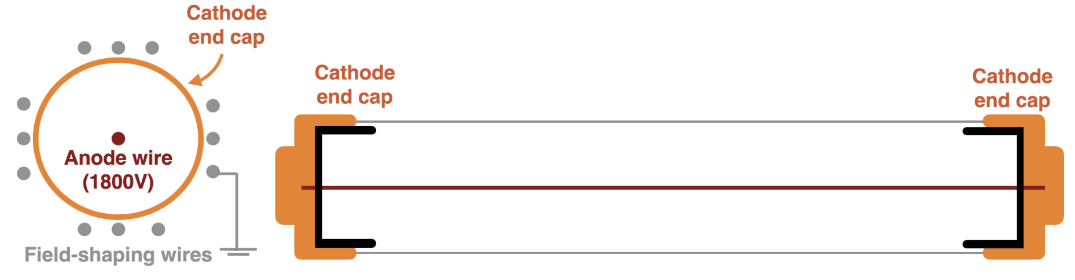
Tracker Cell
Cathode
Electron Passes through cell
Avalanche triggered
Plasma propagates along anode
Plasma reaches both cathode ends
Anode Wire
e-
Cathode

Slide 9
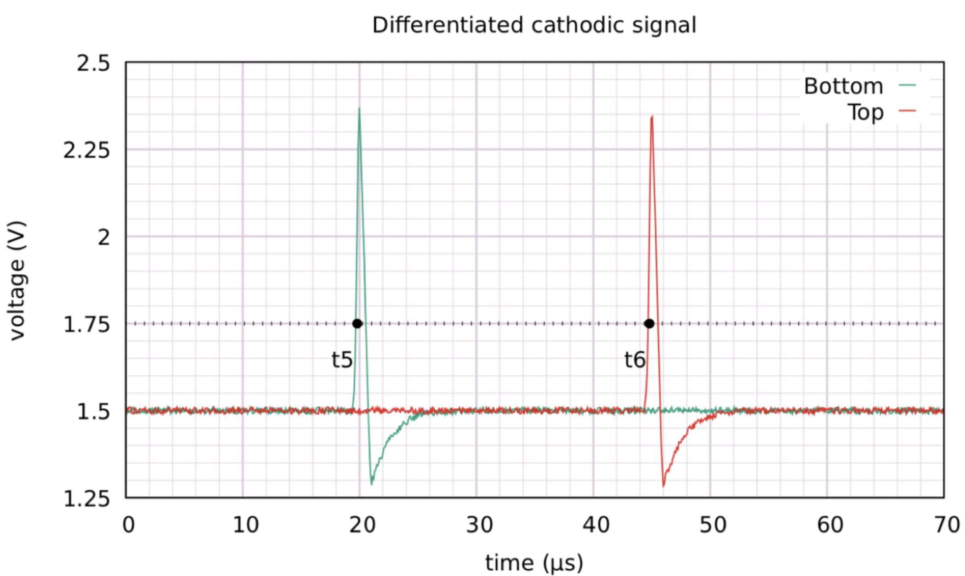
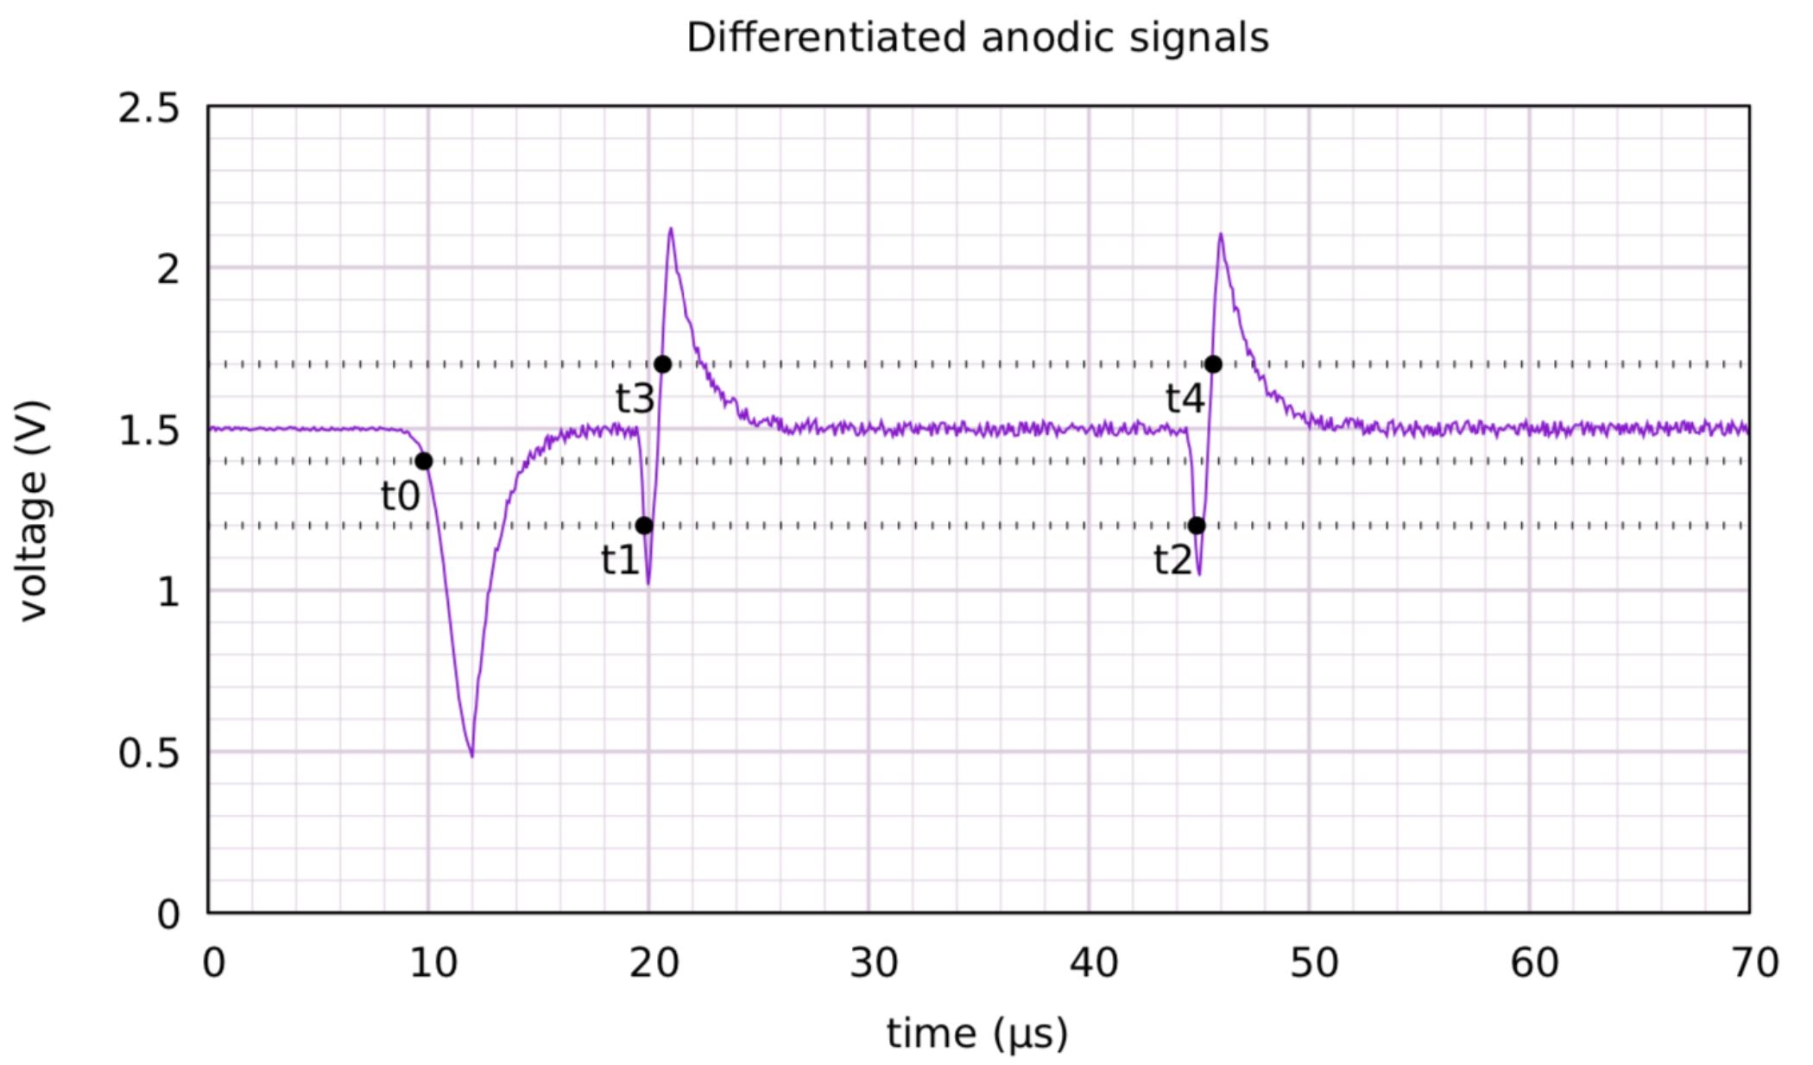
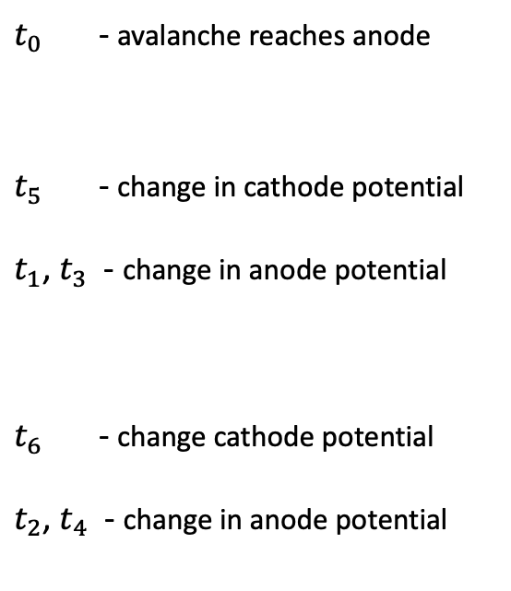
Summary of Tracker Cell timestamps
Cathode
Differentiated Cathode Signal
$t_{0}$ - avalanche reaches anode
$t_{5}$ - change in cathode potential
$t_{1}$, $t_{3}$ - change in anode potential
$t_{6}$ - change cathode potential
$t_{2}$, $t_{4}$ - change in anode potential
Differentiated Anodic Signal
e-
Cathode

Slide 10
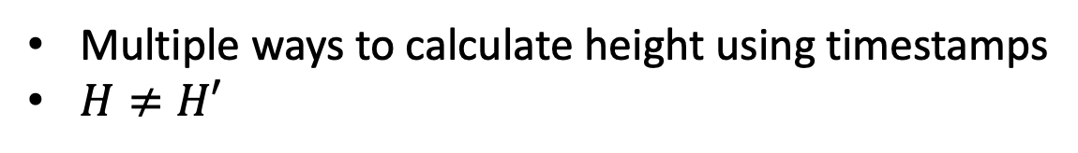
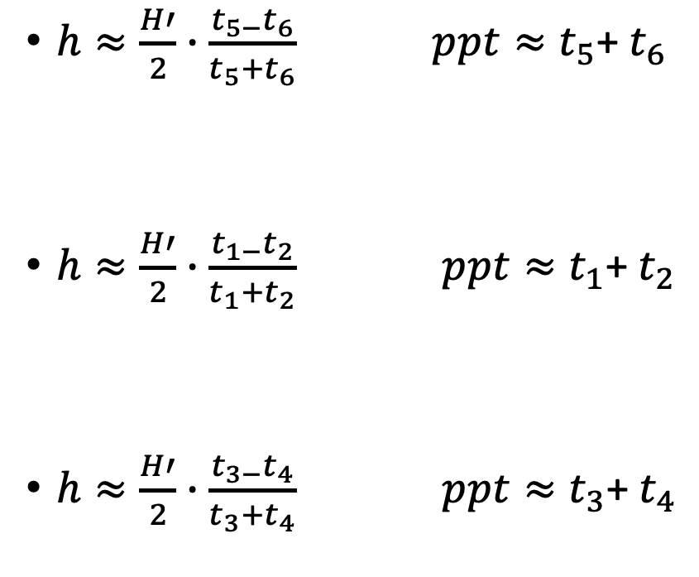
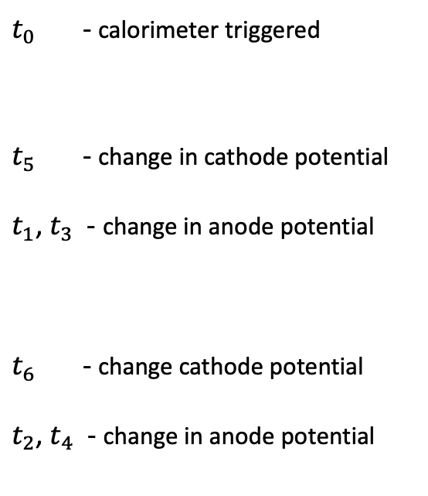
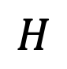
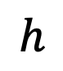
Height of Hit
Cathode
$h≈\frac{H′}{2}∙\frac{t_{5−}t_{6}}{t_{5}+t_{6}} ppt≈t_{5}$+ $t_{6}$
$h≈\frac{H′}{2}∙\frac{t_{1−}t_{2}}{t_{1}+t_{2}} ppt≈t_{1}$+ $t_{2}$
$h≈\frac{H′}{2}∙\frac{t_{3−}t_{4}}{t_{3}+t_{4}} ppt≈t_{3}$+ $t_{4}$
$t_{0}$ - calorimeter triggered
$t_{5}$ - change in cathode potential
$t_{1}$, $t_{3}$ - change in anode potential
$t_{6}$ - change cathode potential
$t_{2}$, $t_{4}$ - change in anode potential
$$H$$
$$h$$
Multiple ways to calculate height using timestamps
$H≠H′$
Cathode

Slide 11
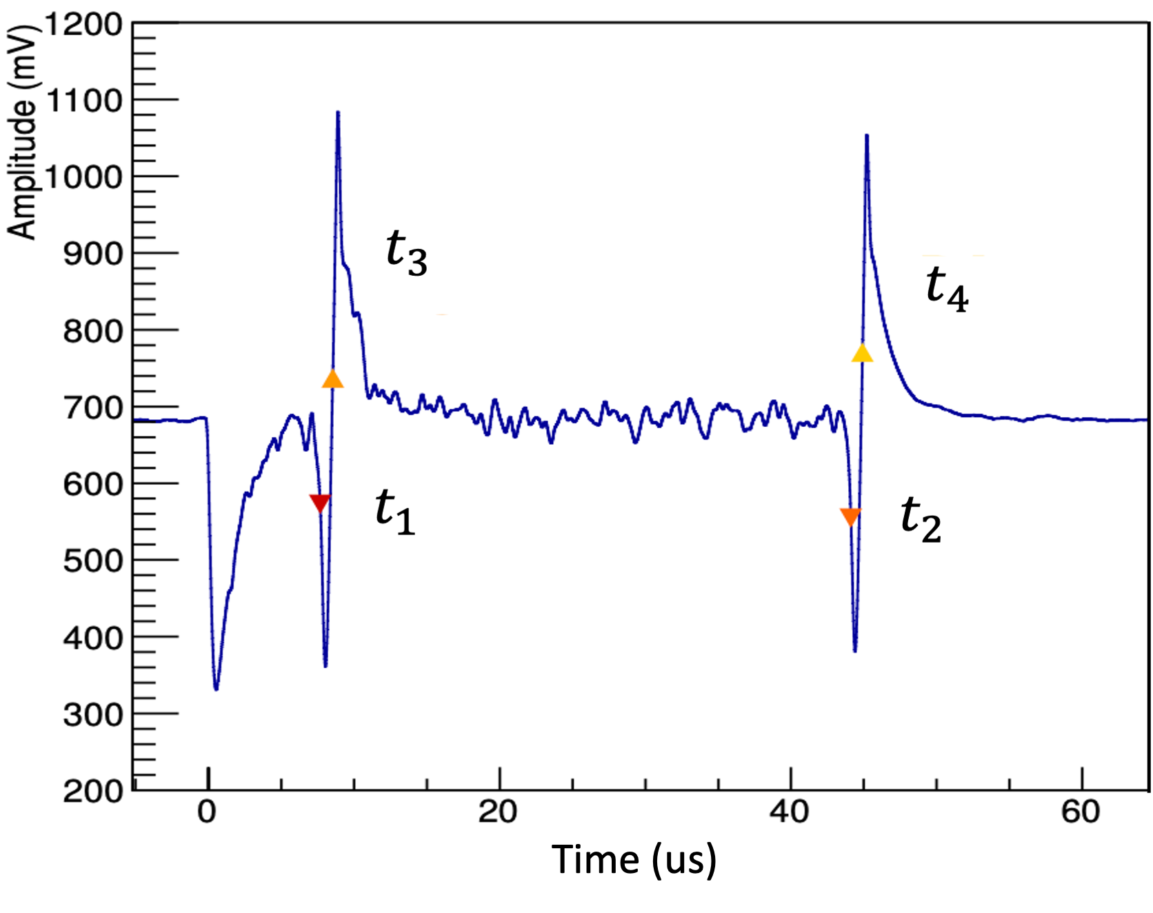
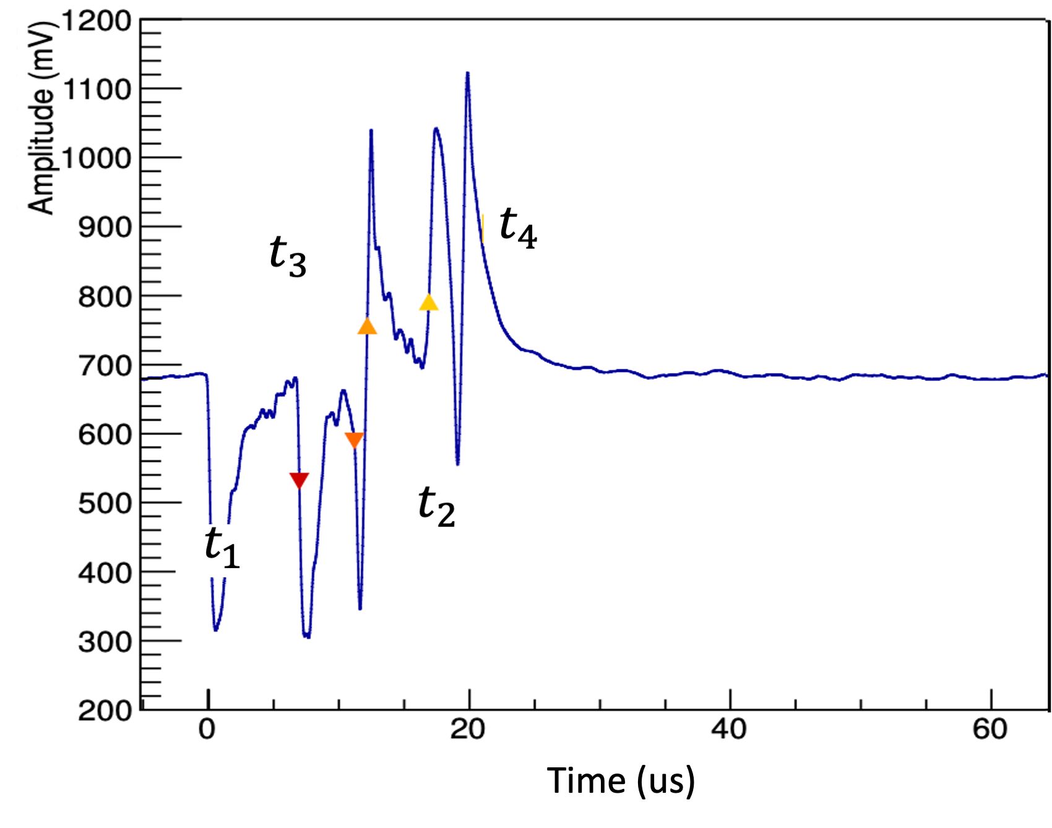
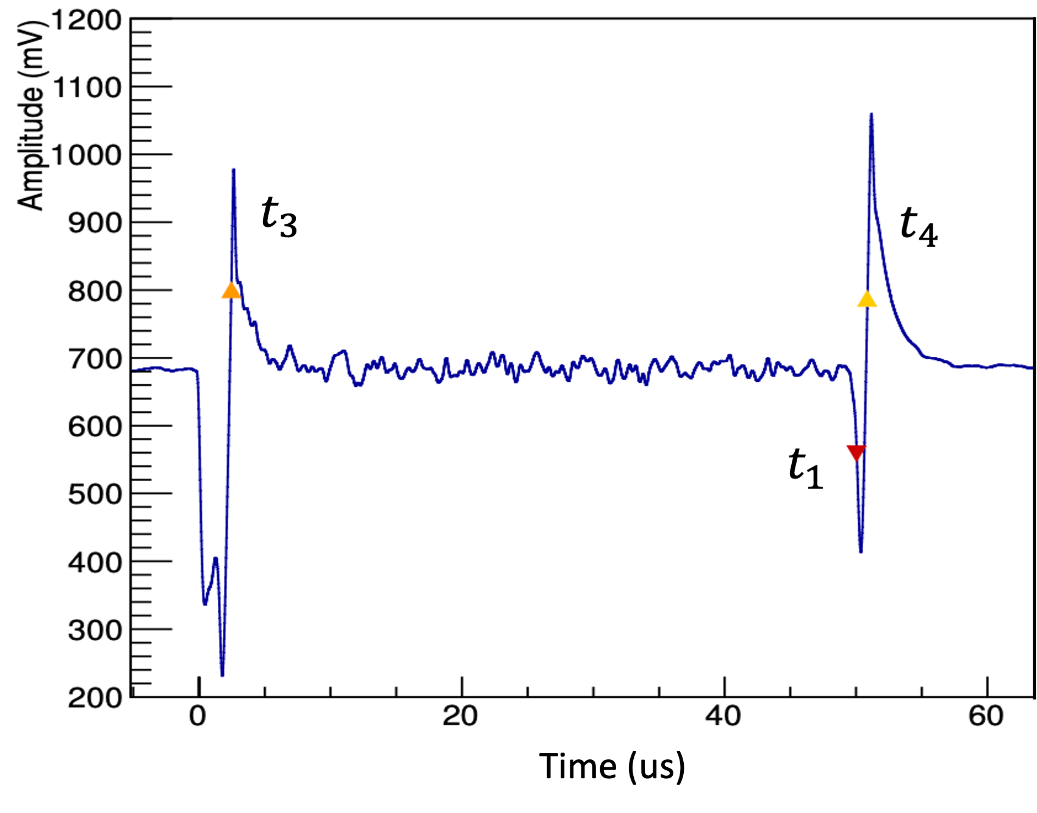
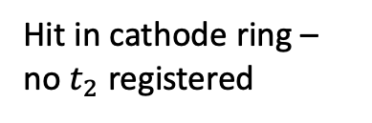
Faulty Timestamps
There are scenarios in which timestamps are not present
Two examples shown below
Ideal Event
Faulty Event
Peaks from previous hit overlap
Hit in cathode ring – no $t_{2}$ registered

Slide 12
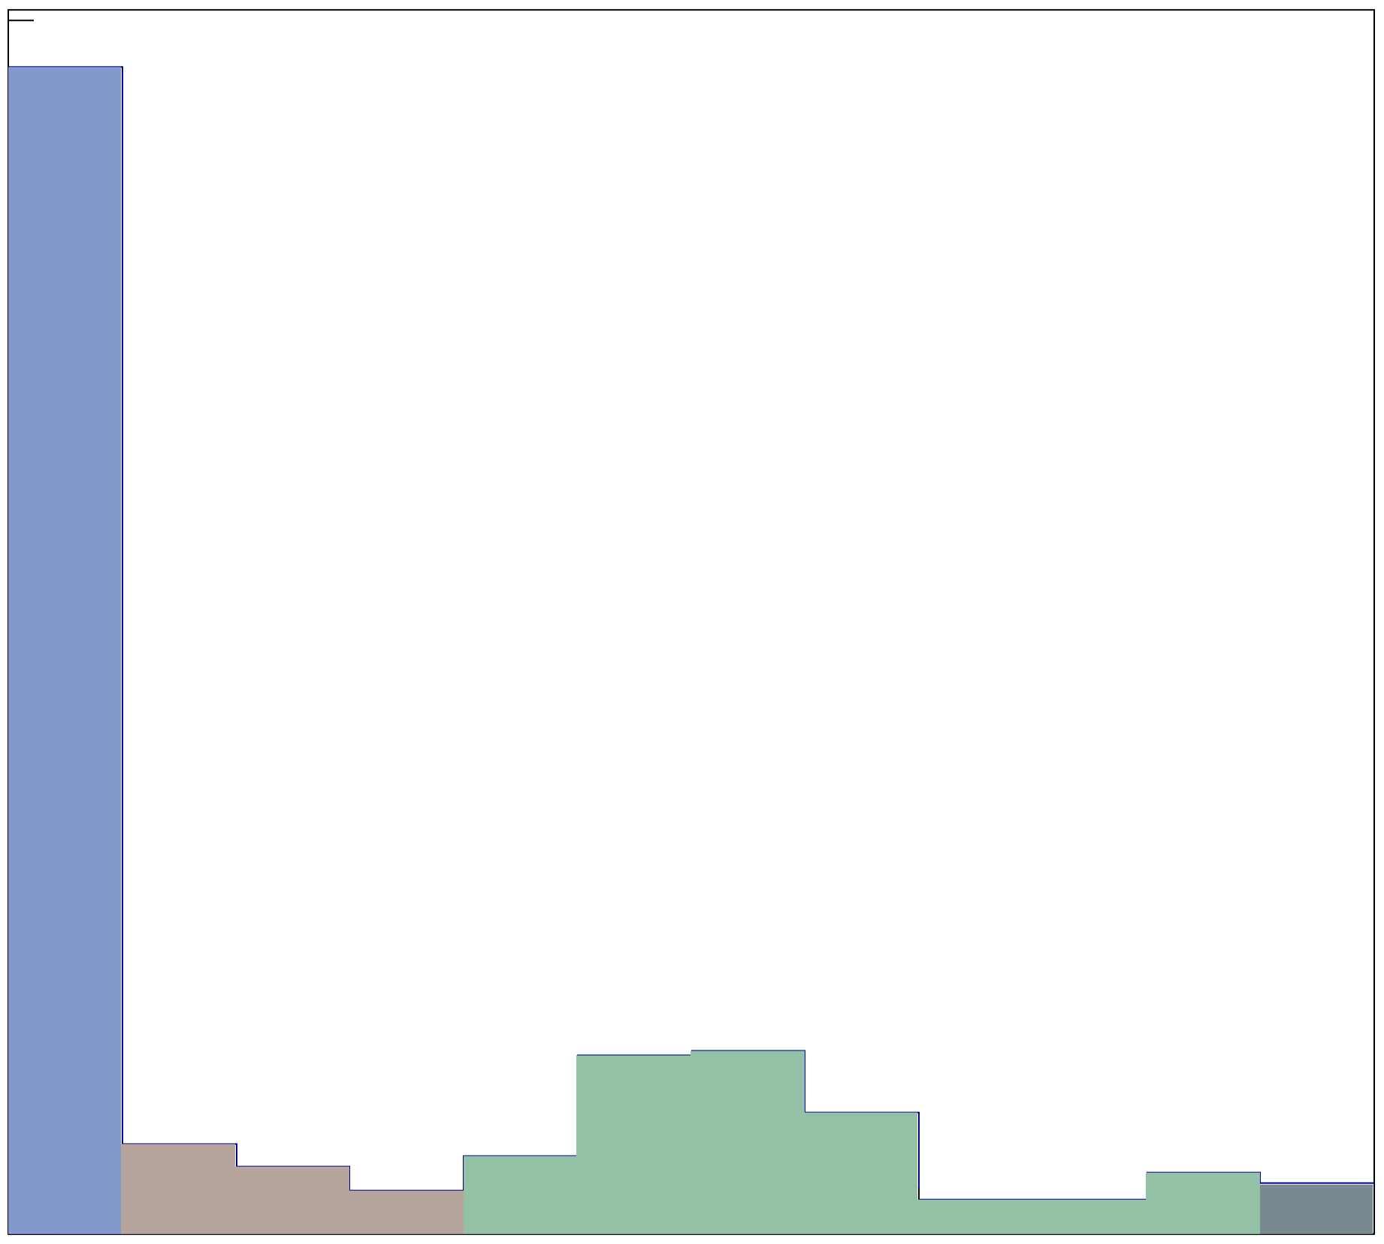
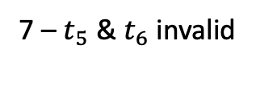
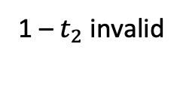
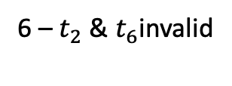
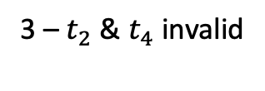
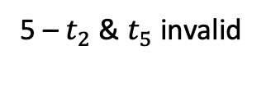
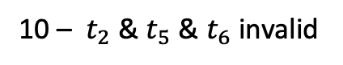
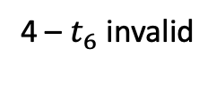
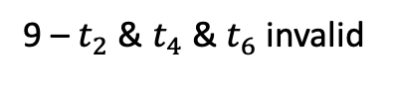
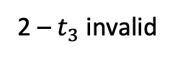
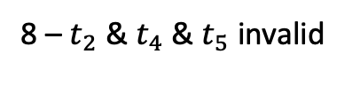
Faulty Scenarios
10 most common faulty TS scenarios
0 – All timestamps valid
6 –${ t}_{2}$ & $t_{6}$invalid
1 – $t_{2}$ invalid
7 – $t_{5}$ & $t_{6}$ invalid
0.5
2 – $t_{3}$ invalid
8 – $t_{2}$ & $t_{4}$ & $t_{5}$ invalid
3 – $t_{2}$ & $t_{4}$ invalid
9 –${ t}_{2}$ & $t_{4}$ & $t_{6}$ invalid
0.4
4 – $t_{6}$ invalid
10 – ${ t}_{2}$ & $t_{5}$ & $t_{6}$ invalid
Hit Count (fraction total hit)
0.3
5 – $t_{2}$ & $t_{5}$ invalid
E – all other scenarios
0.2
0.1
0
1
2
3
4
5
6
7
8
9
10
E
Scenario Label

Slide 13
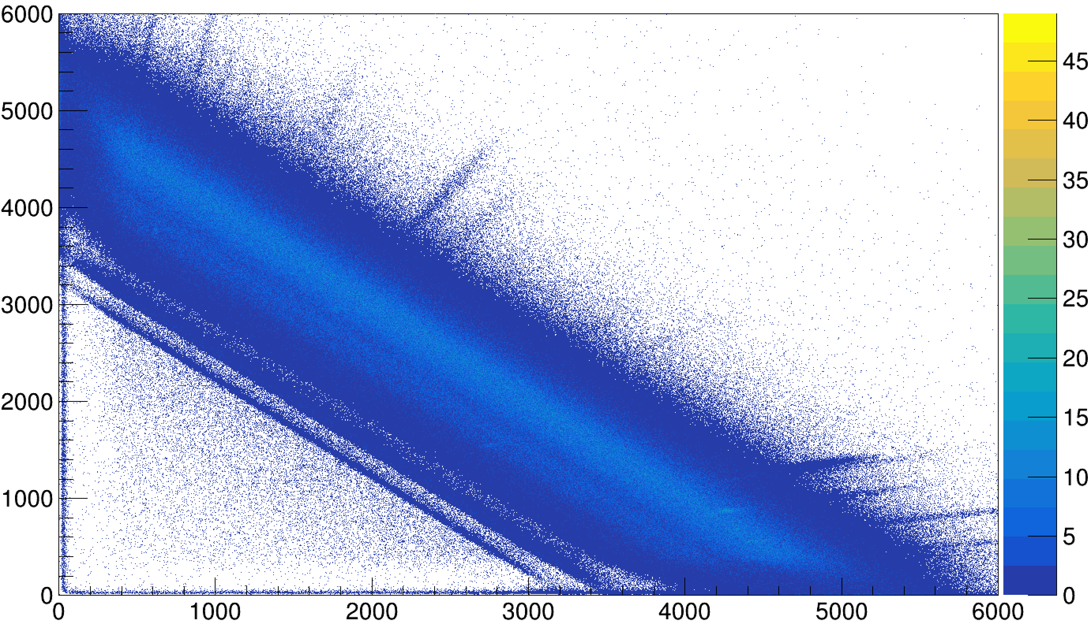
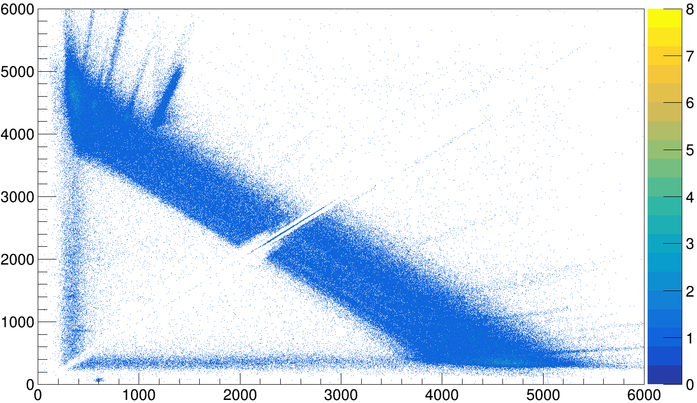
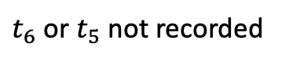


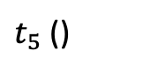
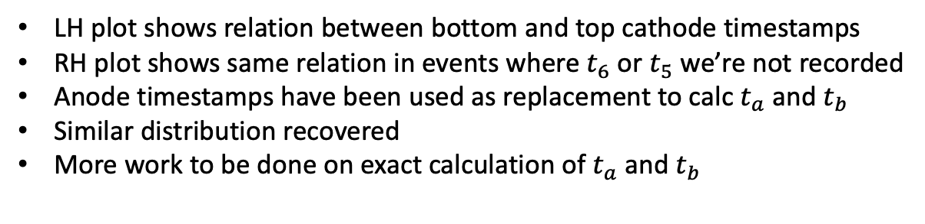
Using anode timestamps as replacements
Ideal Case
$t_{6}$ or $t_{5}$ not recorded
$$t_{6}$$
$$t_{b}$$
$t_{5}$ ()
$$t_{a}$$
LH plot shows relation between bottom and top cathode timestamps
RH plot shows same relation in events where $t_{6}$ or $t_{5}$ we’re not recorded
Anode timestamps have been used as replacement to calc $t_{a}$ and $t_{b}$
Similar distribution recovered
More work to be done on exact calculation of $t_{a}$ and $t_{b}$

Slide 14
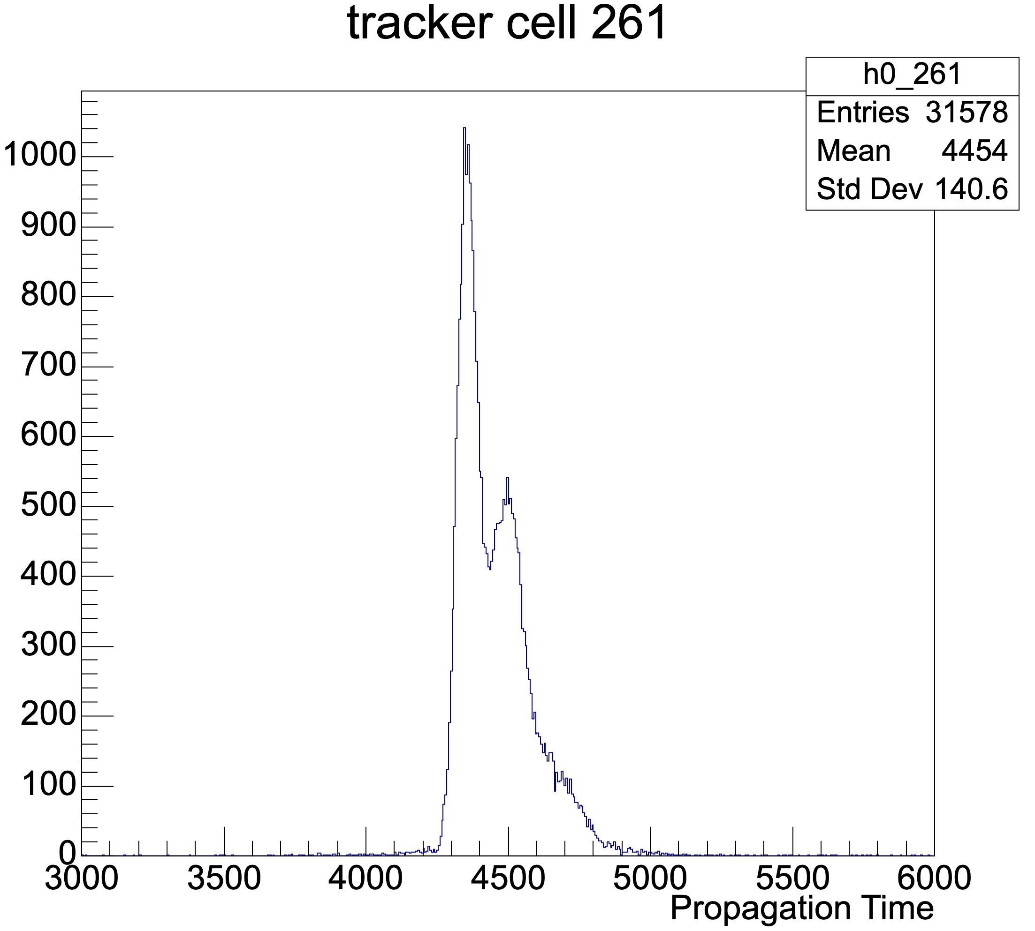
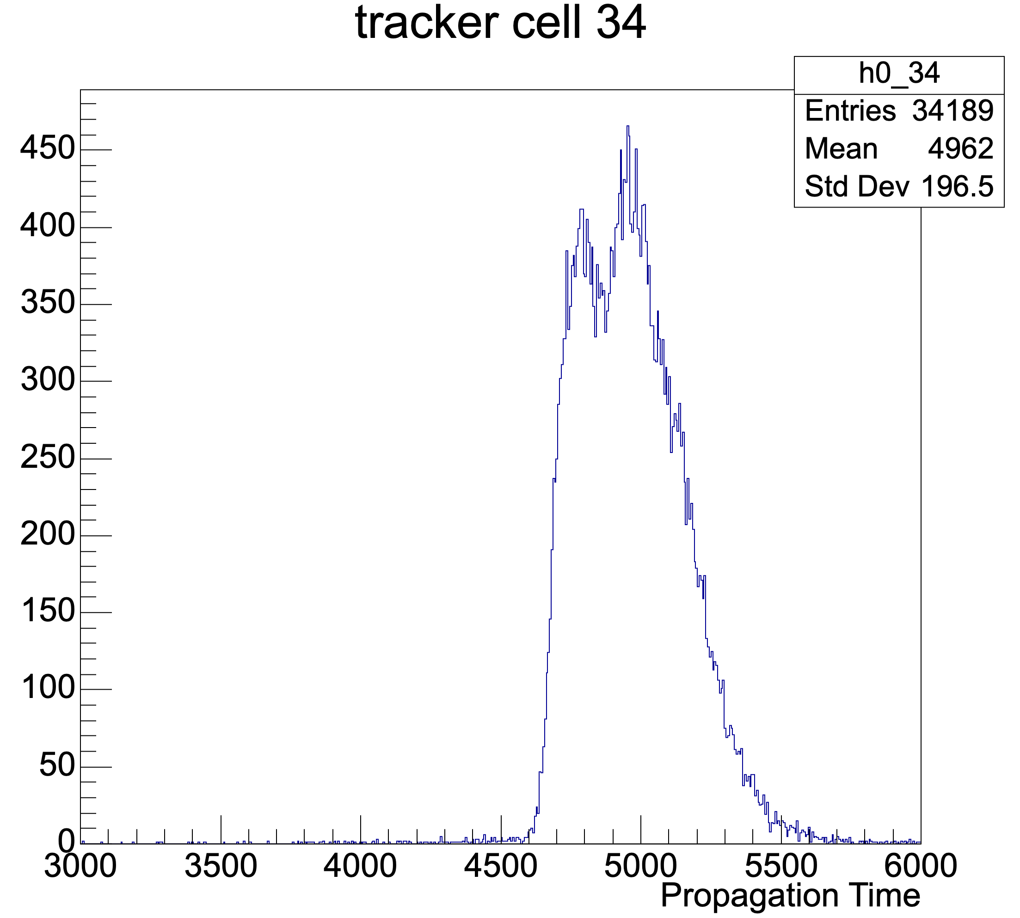
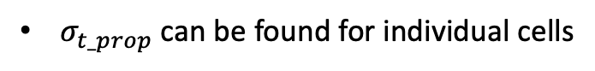
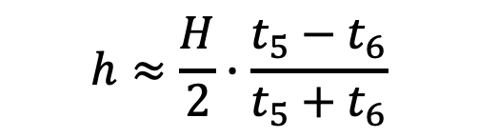
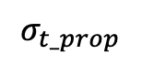
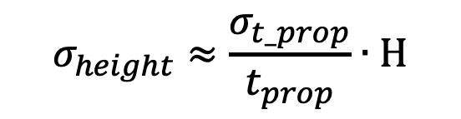
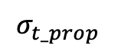
Uncertainty Considerations
Resolution of the longitudinal position:
$$h≈\frac{H}{2}∙\frac{t_{5}−t_{6}}{t_{5}+t_{6}}$$
$$σ_{height}≈\frac{σ_{t_prop}}{t_{prop}}∙H$$
$σ_{t_prop}$ can be found for individual cells
$$σ_{t_prop}$$
$$σ_{t_prop}$$

Slide 15
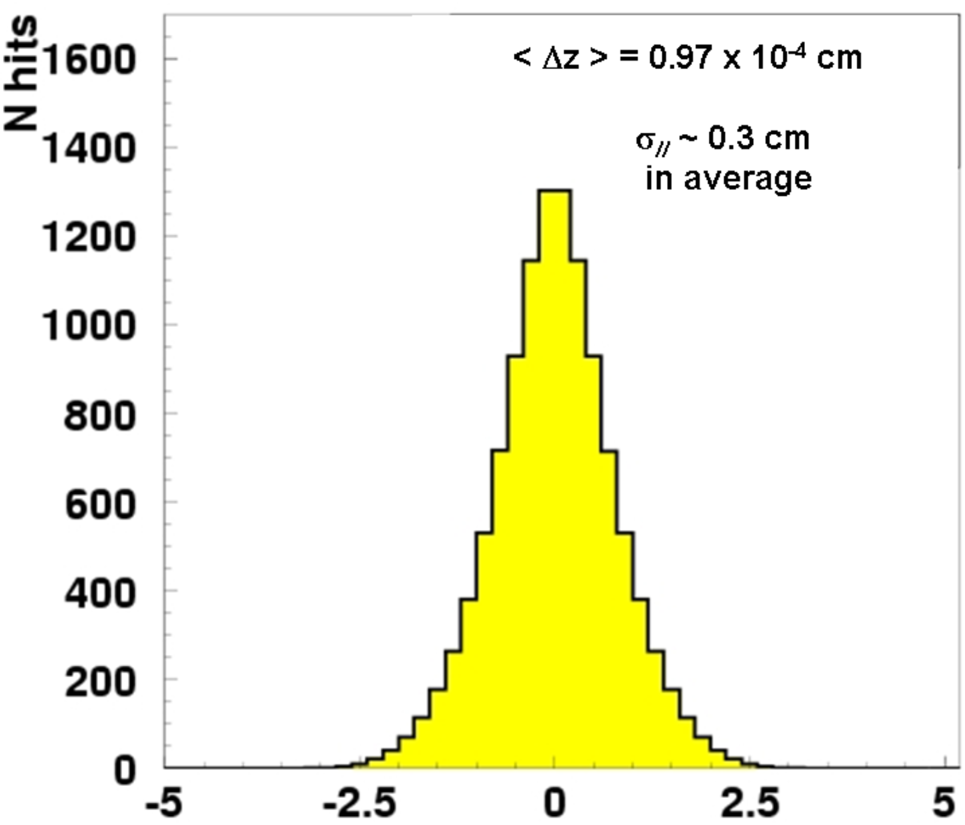
Uncertainty Considerations - continued
Tracker
Can verify uncertainty of ppt or height estimate via track fitting
Use this as regular check in analysis or only verification of method??
Certain variables also affect resolution:
δ₅
δ₂
δ₄
δ₃
δ₁
Distribution we expect to see
Angle of the hit
Height of hit in cell
θ
Use of anode timestamps
e-
δ (cm)

Slide 16
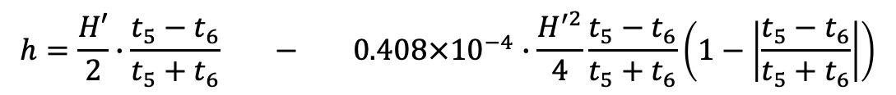
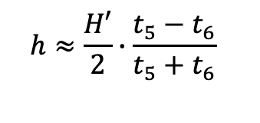
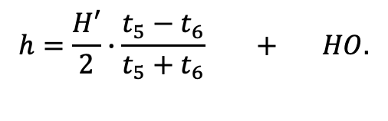
Height calculation
Height equation assuming constant v:
NEMO-3 vertical position calculation:
$$h≈\frac{H′}{2}∙\frac{t_{5}−t_{6}}{t_{5}+t_{6}}$$
$$h=\frac{H′}{2}∙\frac{t_{5}−t_{6}}{t_{5}+t_{6}} + HO.$$
$$h=\frac{H′}{2}∙\frac{t_{5}−t_{6}}{t_{5}+t_{6}} − 0.408×{10}^{−4}∙\frac{H^{′2}}{4}\frac{t_{5}−t_{6}}{t_{5}+t_{6}}\left(1−\left|\frac{t_{5}−t_{6}}{t_{5}+t_{6}}\right|\right)$$
First order term – assumes constant plasma velocity
2nd order correction - accounts for decreasing plasma speed
More sophisticated correction can be designed that takes into account:
time since cell last hit
time since neighboring cells hit
angle electron passed through cell
position of hit in cell
effect of using anode timestamps

Slide 17
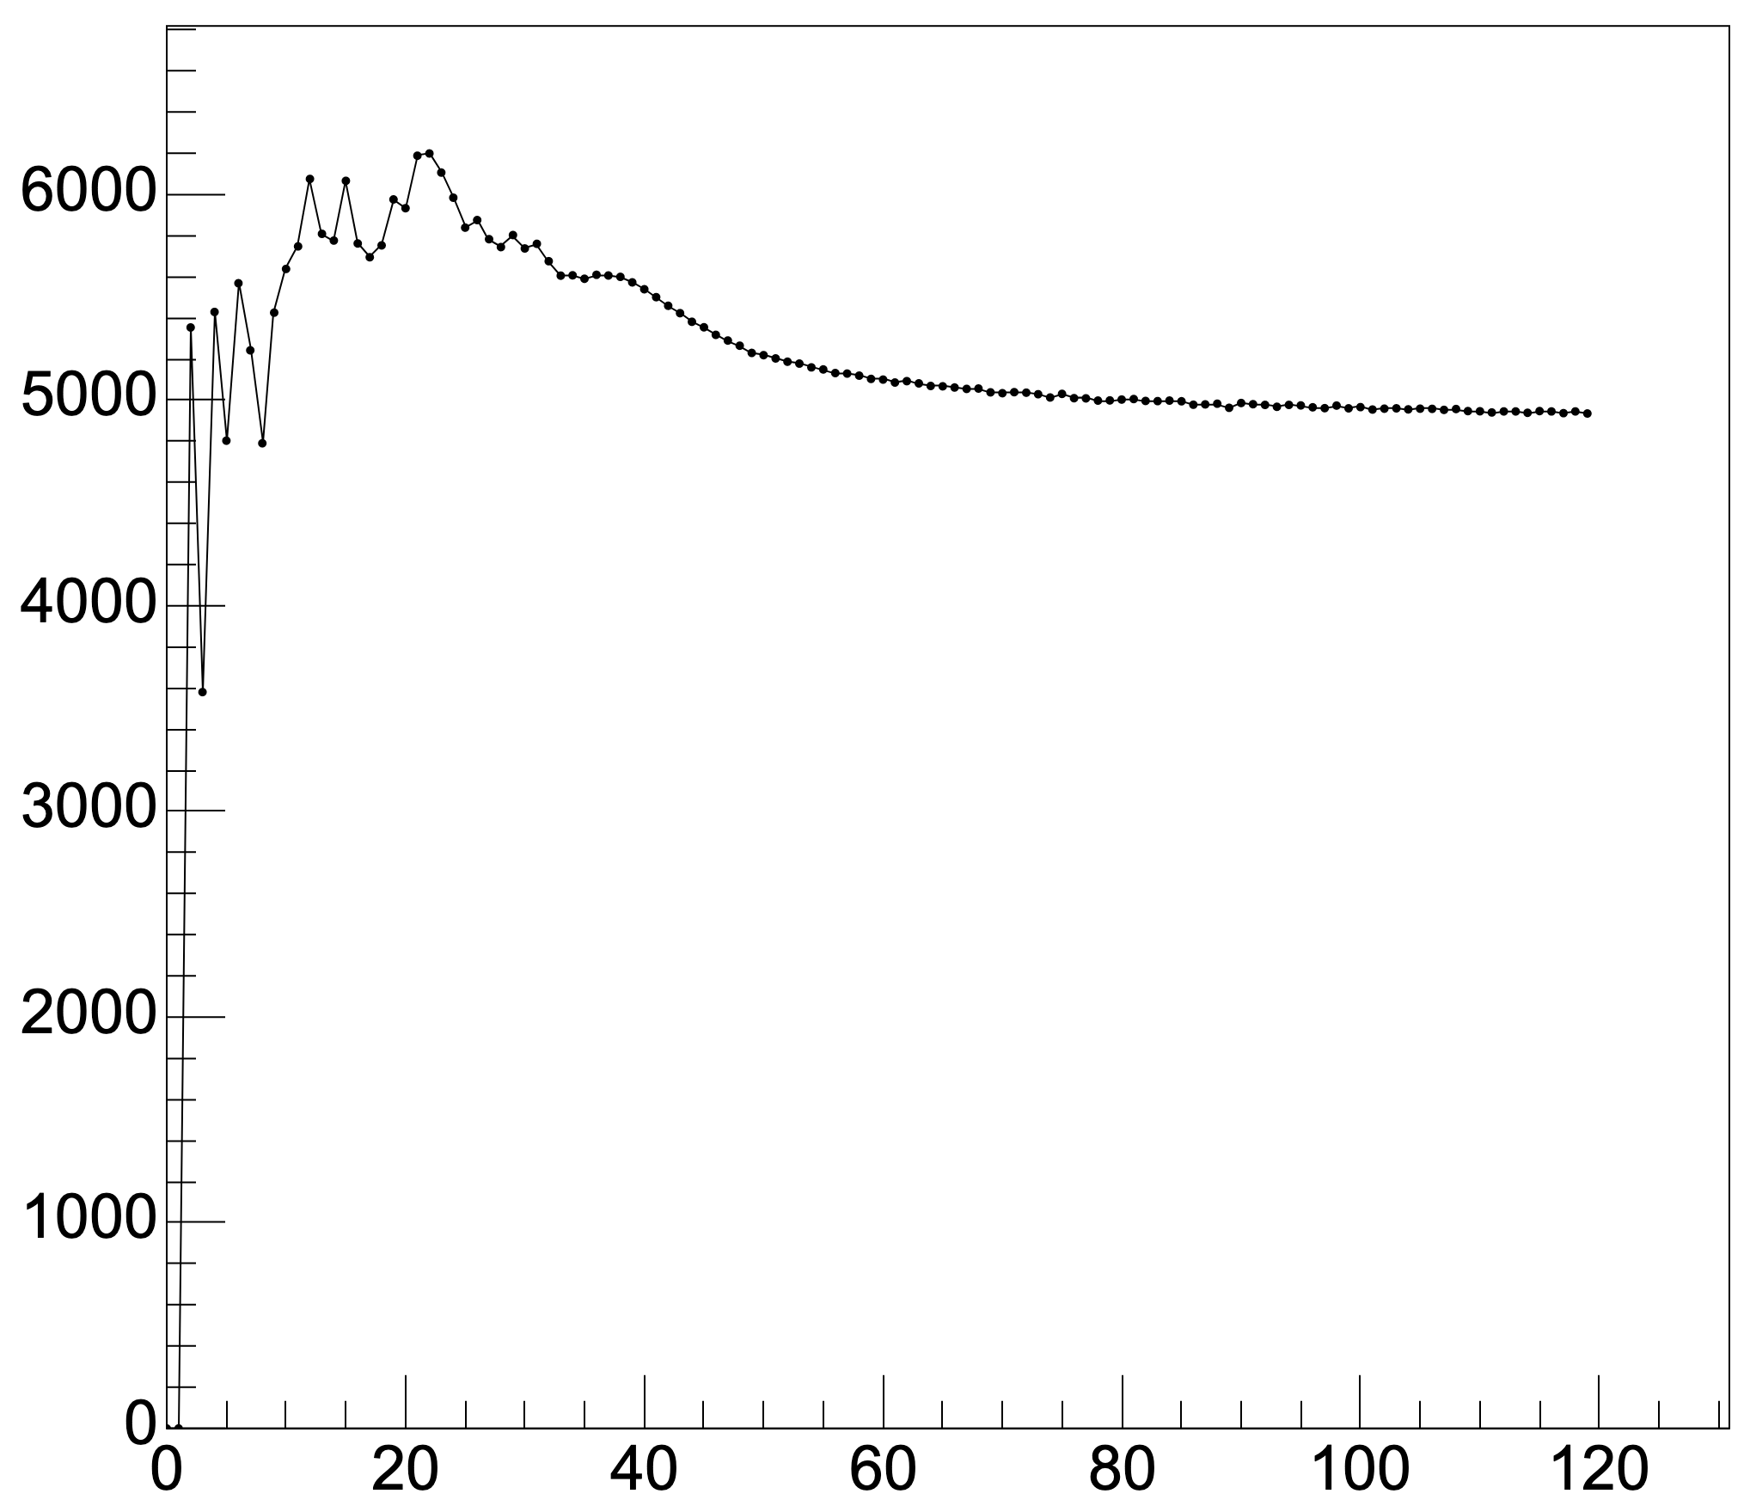
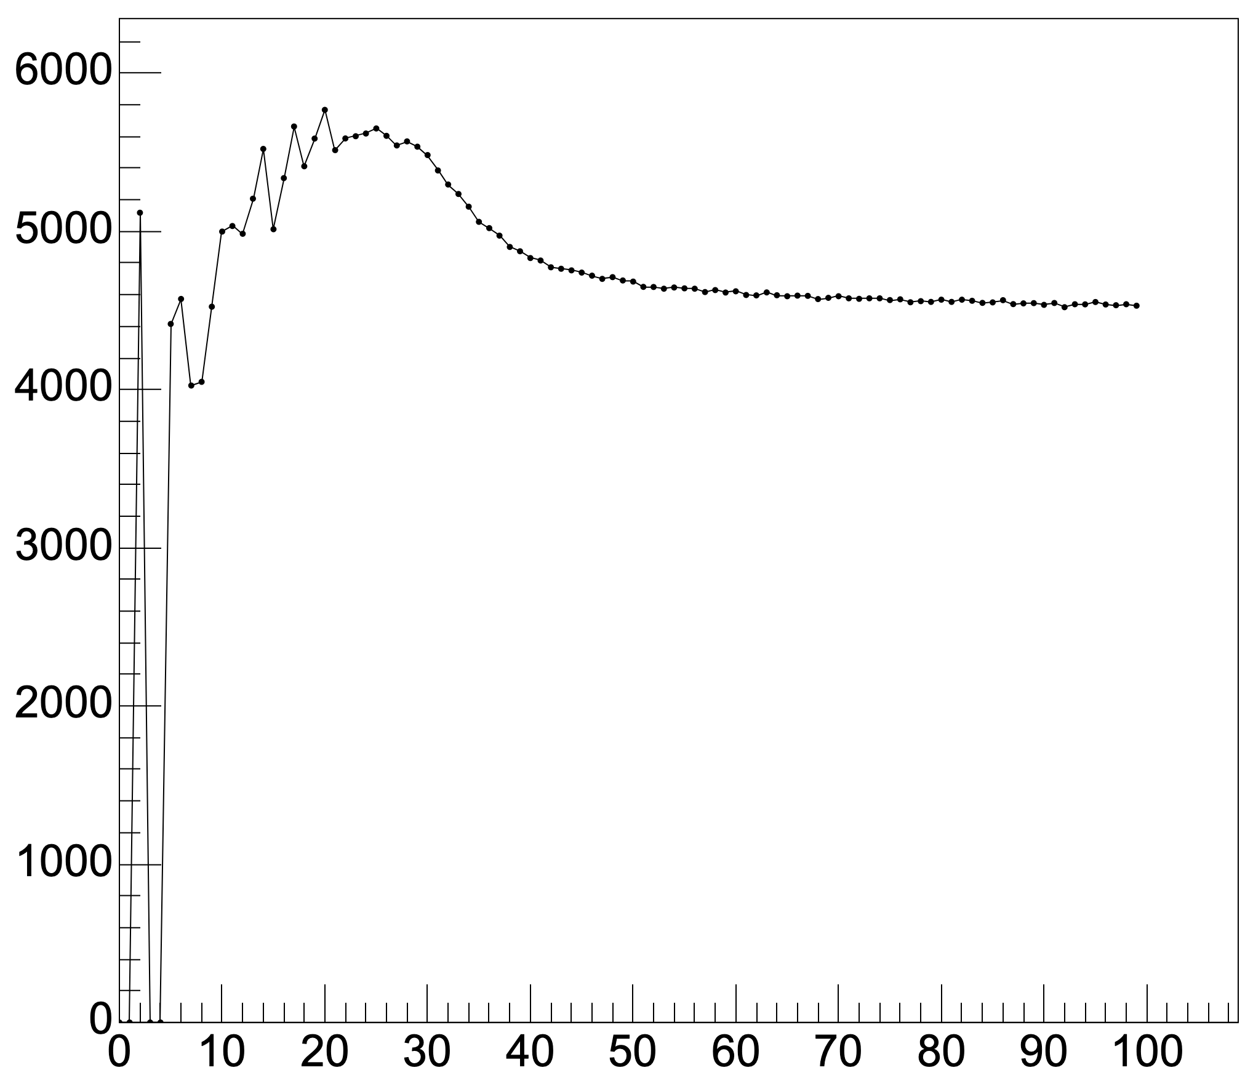




Effect of successive hits on plasma propagation time
1051
902
840
Plasma propagation time
Plasma propagation time
Plasma propagation time
Time since previous hit in same cell (sec${10}^{−4}$)
Time since previous hit in same cell (sec${10}^{−4}$)
Time since previous hit in same cell (sec${10}^{−4}$)
Correction could be applied to NEMO data – take into account last hit time to correct z calculation
Similar effect

Slide 18
Summary
Tracker timestamps need to be replaced in some situations
There are multiple ways in which timestamps can be misrecorded
A method for assessing the uncertainty of vertical position has been outlined
A different method for calculating vertical position has been suggested

Slide 19
Backup Slides

Slide 20

Voltage Signals

Slide 21

Avalanche Overview

Slide 22
Timestamps Overview
In normal scenario: t5 ~ t1, t3
t6 ~ t2, t4
In other scenarios these relations don’t hold
Prevents vertical position calculation
Aim is to produce code that recovers vertical position using other timestamps

Slide 23


Variables affecting longitudinal resolution
θ
NEMO-3 data
e-
Angle of the hit
Height of hit in cell
Nearby active cells

Slide 24



Non-constant plasma velocity
Time since hit (AU)
840
1051
902
Plasma propagation time
Plasma propagation time
Plasma propagation time
Height in cell
Height in cell
Height in cell

Slide 25
Effect of successive hits on plasma propagation time
1051
902
840
Plasma propagation time
Plasma propagation time
Plasma propagation time
Time since previous hit in same cell (sec${10}^{−4}$)
Time since previous hit in same cell (sec${10}^{−4}$)
Time since previous hit in same cell (sec${10}^{−4}$)
Correction could be applied to NEMO data – take into account last hit time to correct z calculation
Similar effect

Slide 26

Plasma propagation times

Slide 27



Plasma propagation time
1051
902
Time since run began (s)
Plasma propagation Time
CALO HT=50 LT=25 ; Tracker default
TRACKERHV 1550/1550/1570
CALO HT=100mV LT=50mV ; TRACKER GA=40 HNT/LNT/HPT=1.4/1.6/1.8

Slide 28


Cathode Timestamps
All hits with both cathode timestamps registered
General trend as expected
Unexpected fringe pattern
Unexpected data points near each axis
Crate dependency as expected
Crate 1
Crate 2
Bot_Time = -Top_Time + Plasma_Propagation_Time
Bot Time
Top Time
Top Time
Notes:
Plot shows top cath time vs bot cath time in event event where both cathode timestamps were valid and present
In ideal scenario would expect this plot to show one diagnol line through symmetric about y=x
This corresponds to a constant plasma propagation time
That general trend is as expected here
Key comments:
Strange situations where get fringes in the data
could be faulty cells - will investigate in future what causes this - can mitigate this effect somehow?
Get data points near each axis for some reason
The difference in plasma propagation times for each crate can also be seen
can use these timestamps to recover the vertical position of the electrons using equation shown

Slide 29

Plasma propagation time
Plasma propagation Time
Time since previous hit in same cell

Slide 30

pCD data storage
Data structure
UDD → pCD
R1,R2,R3,R4,R5 → drift time, cathodes[3]*, PPT[3]*
Uncertainties on these values
What else add?
Include cd
Pcd format more unsure

Slide 31
Height correction
In NEMO-3:
H’ = 2620mm
H = 2700mm
Different dimensions for SuperNEMO tracker cell but does same concept apply?
“Cathode signals exceed their electronic threshold a few cm before the plasma reaches the cathode ring”

Slide 32

Plot r5 and r6 like this aswell
(first and last – not r5 r6)
Clearly shows the fault is depenant on how goes wronmg
But this might already have been pointed out
By previous slide –
Perhaps this would be useful as an extra slide?
Too much detail otherwise???

Slide 33
Fringes
Do fringes still exist in these cases of specific scenarios
Show results of how well replacements worked for previous scenarios- Compared to how normal distribution looks with
R5 and R6

Slide 34
What is the point of this talk?
General overview of tracker timestamps for certain people
Examples of cases where the timestamps are faulty
Update on info ability to correct using anode and cathode timestamps
Uncertainty analysis on these values
Opportunity for updated vertical position correction

Slide 35


Non-constant plasma velocity
Simple velocity model of the plasma
Can measure this distribution !
Ie. Plasma slows down over time in this model, results in hits in middle having shorter plasma propagation times
Other factors may affect – eg.successive hits in nearby
Cells – maybe apply a correction factor here aswell
Velocity of plasma (AU)
Plasma propagation time (AU)
Evidence for decelerating plasma
Small correction factor could be added like
In nemo 3
Centre of cell
Time since hit (AU)
Height of hit (z/l)
840
1051
902
Plasma propagation time
Plasma propagation time
Plasma propagation time
Height in cell
Height in cell
Height in cell

